Slide 1
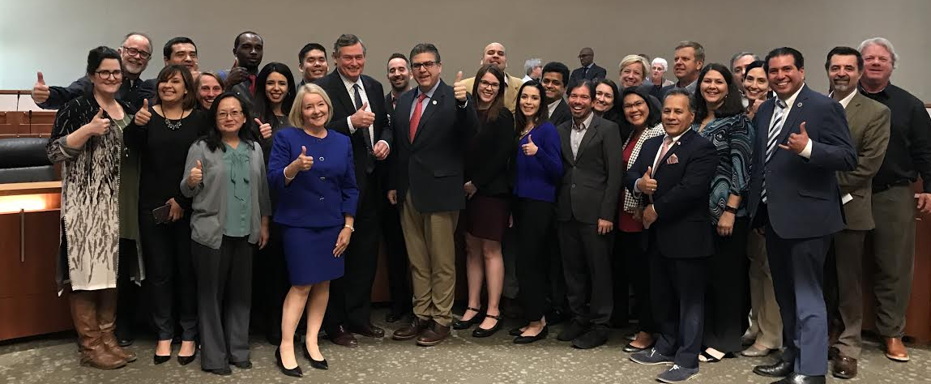
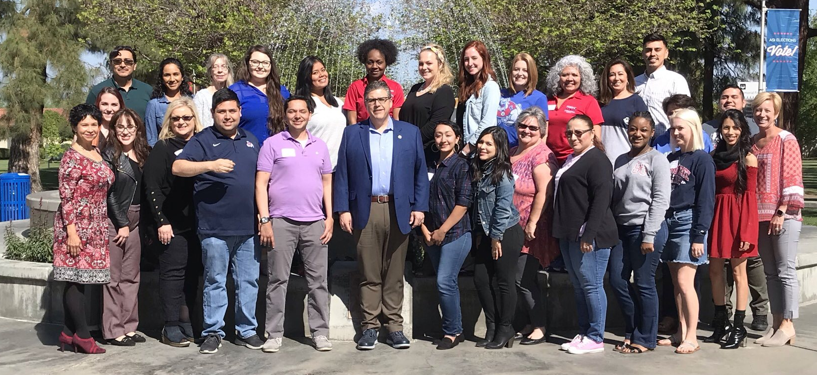




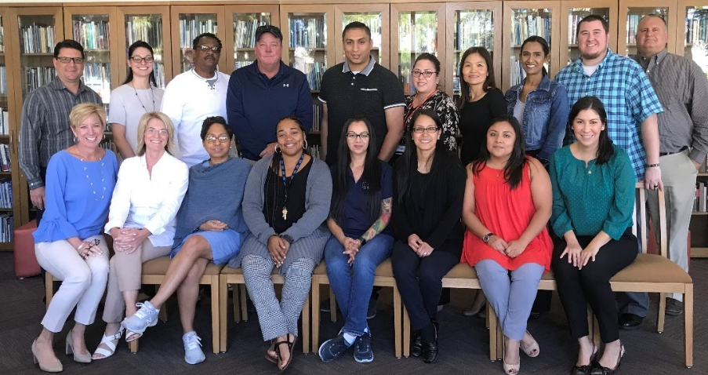
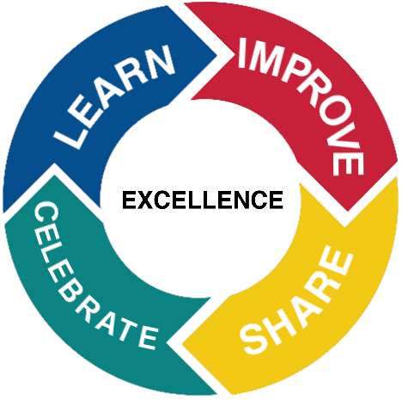
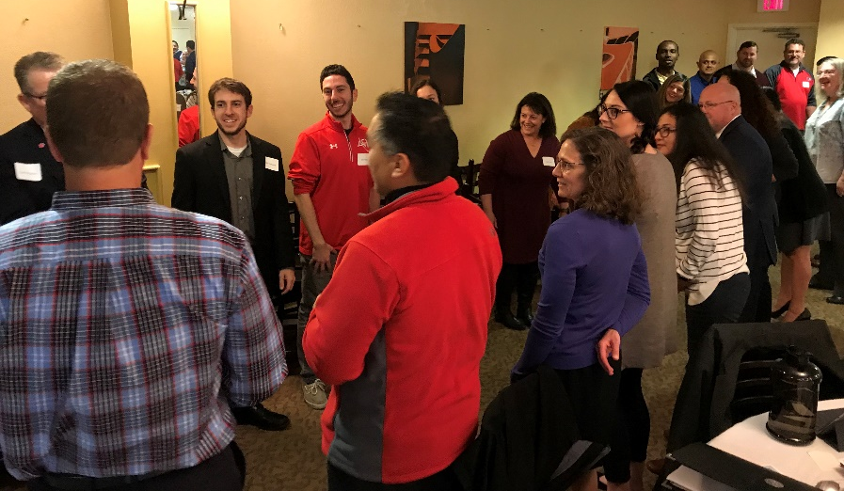
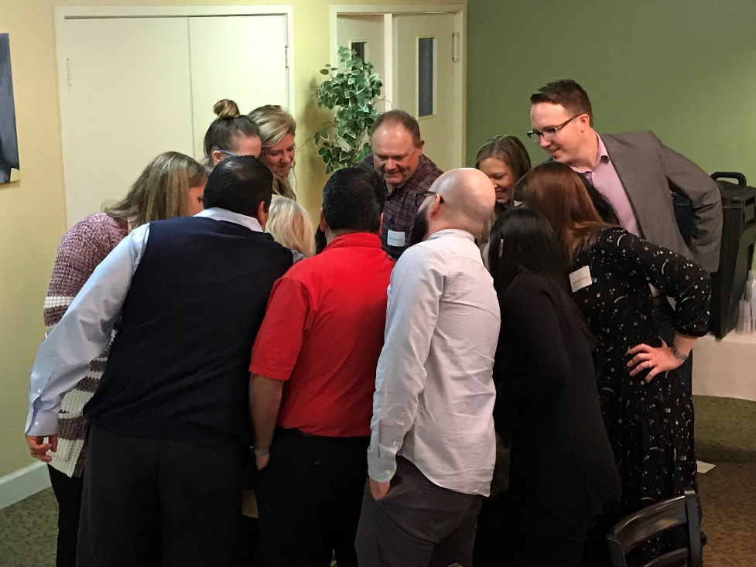
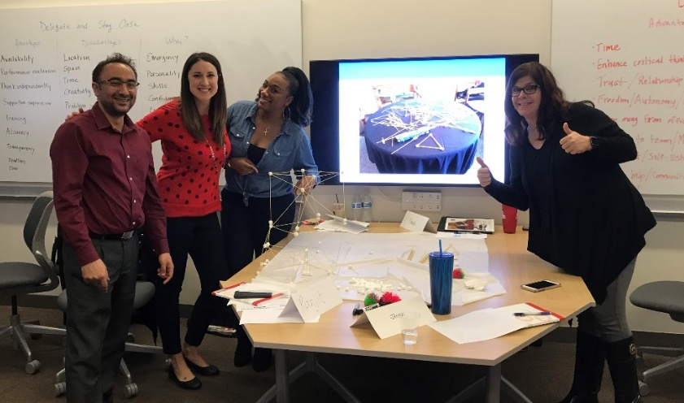

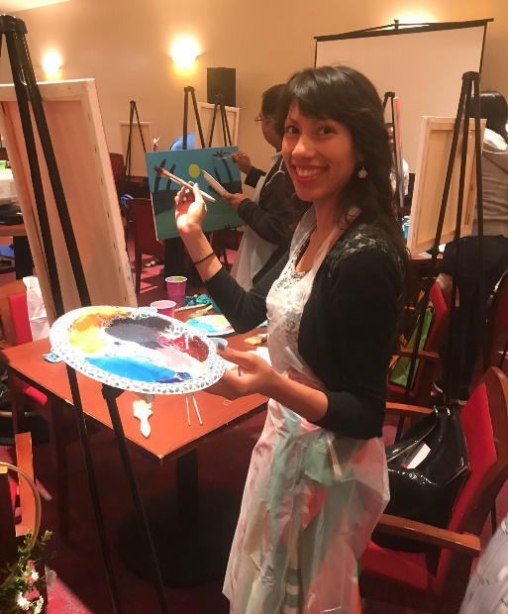
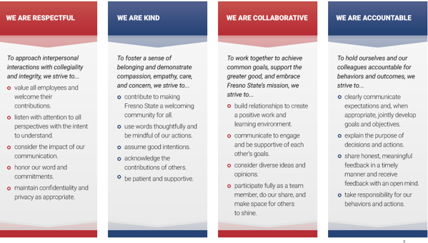
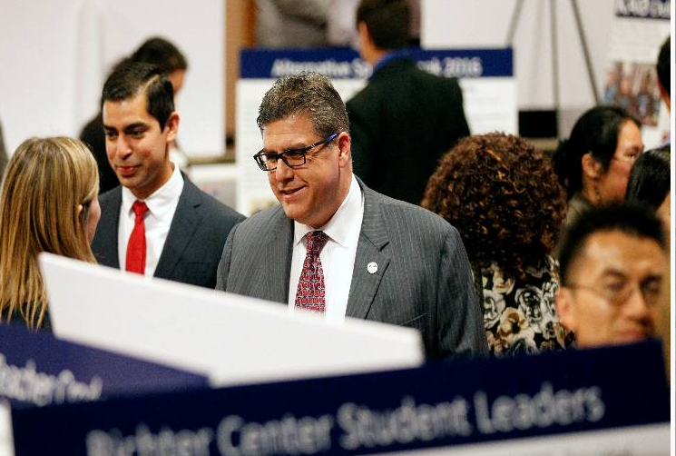
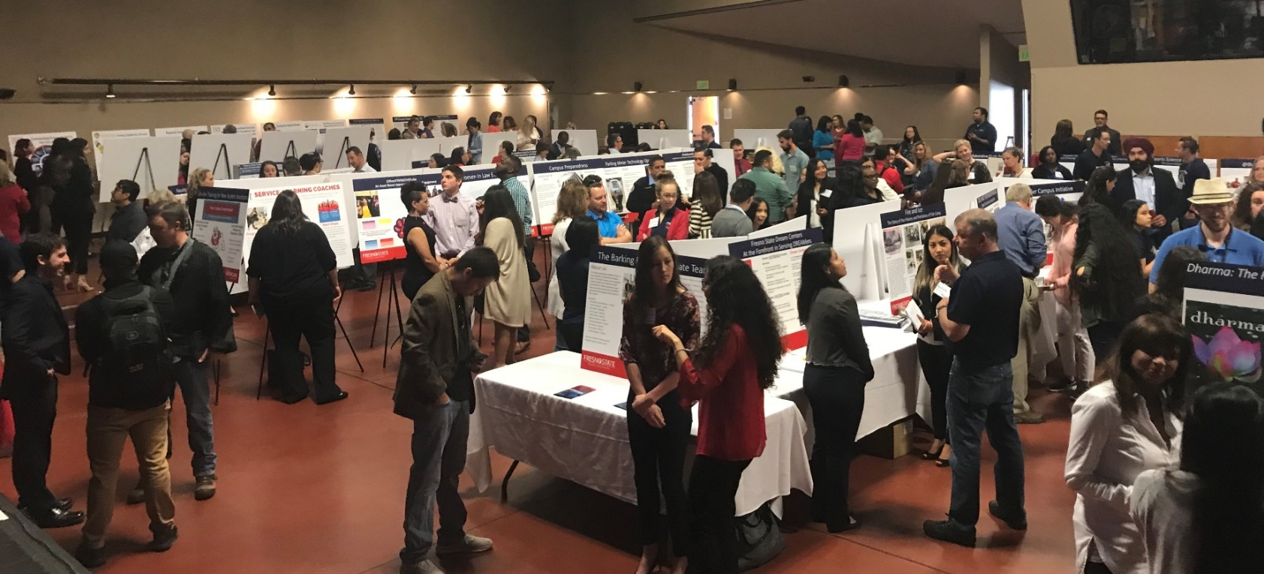
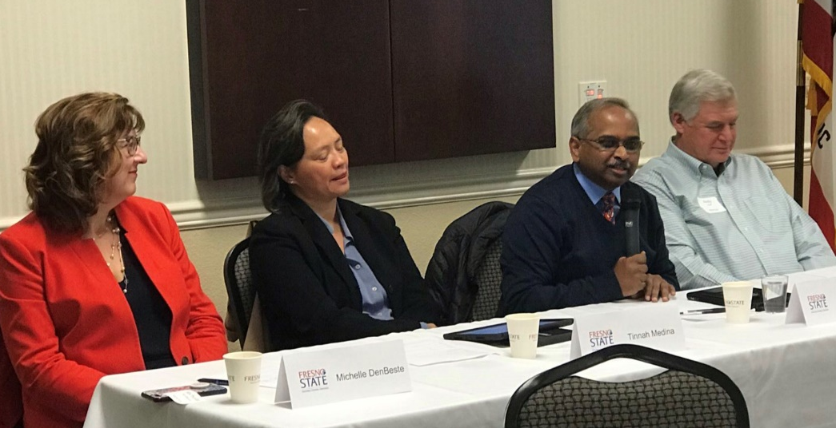
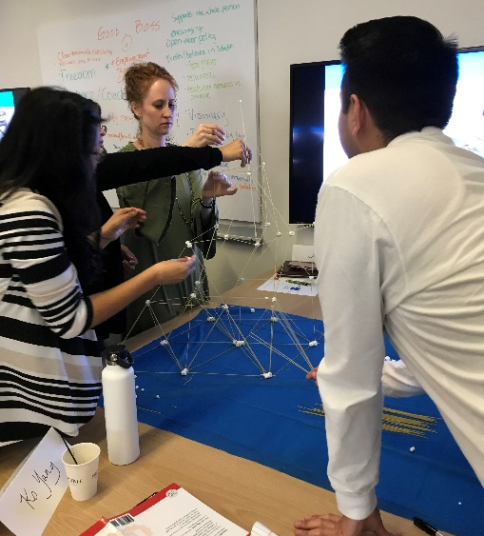
Campus Collaborations Improve
Workplace Quality
President’s Leadership Academy
Strengthening the culture of leadership
Creativity and Innovation for Effectiveness: CAIFE 3.0
Administrative Academy
CAIFE is a unique organizational development program that engages faculty, staff, students and administrators in the process of institutional transformation. CAIFE strengthens the culture of creativity and innovation at Fresno State
10 CAIFE Projects and Teams 70 participants
Strategic Priority 1 | Kids Locker / Diaper Bank
 | Graduate School at Fresno State
 | iGaps
 | Clearinghouse for Undergraduate Research
Strategic Priority 2 | Faculty/Staff recognition program / digital badging
 | Student Assistant Mentor/Development Program
 | Out at Fresno State
Strategic Priority 3 | Maker Space
Strategic Priority 4 | Blended Arts Festival
 | Bulldog Transfer Center
1
Bold Ideas Challenge
2
Bold Ideas Review by CAIFE cohort 1 and the President’s Cabinet
3
CAIFE teams formed and project work begins
10 CAIFE teams (65 participants representing faculty, staff and students) have worked throughout 2018/19 to implement the Bold Ideas.
Year long interactive and reflective development experience for current and emerging leaders.
A learning community for administrative support professionals. 45 employees completed the Administrative Academy in 2018/19.
Learning and Development
Individual skill building workshops offered throughout the year. Courses are organized into the following tracks.
Change Management & Continuous Improvement
Navigating Fresno State
Developing a Healthy U
Enhancing Technical Skills
Supervision for Managers and Department Chairs
Lunch and Learn Series
Online learning resources
Wellness Activities and Fitness Classes
Organizational Excellence supports numerous continuous improvement projects to reduce administrative burden, improve efficiencies and support change and transition.
STAR Day – May 24, 2019
Measuring and Improving Workplace Quality
Staff Training And Recognition (STAR) Day is a full day professional development event with opportunities to learn, celebrate and have fun with fellow colleagues. The day features a keynote address, workshop, and closing session with speaker, Shola Richards, as well as a number of breakout sessions and a Service Awards Luncheon where staff are recognized for their milestone years of service to Fresno State.
Principles of Community: How we treat each other
Workplace Quality Survey
In 2017 we conducted our first Workplace Quality Survey to help us better understand faculty and staff perceptions of our work environment. One of the action items that came as a result of feedback received was to engage campus in conversation about how we treat each other. This resulted in our Principles of Community. A second survey was conducted in spring 2019 and the results will be shared in fall.
Angelica Reyes, staff, expresses her creativity painting during one of last year’s workshops.
President’s Showcase of Excellence
This year marks the 5th annual President’s Showcase of Excellence celebrating innovation and excellence across campus. Over 100 posters sharing stories of innovation, excellence, and achievement from across Fresno State’s campus are featured.
Faculty and Staff Mentor Program
Fresno State 101
Welcome New Employees!
28 faculty and staff were paired with seasoned campus leaders as part of Fresno State’s joined faculty-staff mentor cohort.
Organizational Development:
Building stronger teams
A new half day new employee training was launched in spring 2019. This program complements other onboarding efforts and is sponsored by Organizational Excellence, University HR and Auxiliary HR.
Organizational Excellence helps with team building, focus groups, retreat planning and facilitation, custom workshops and much more.

