Slide 1
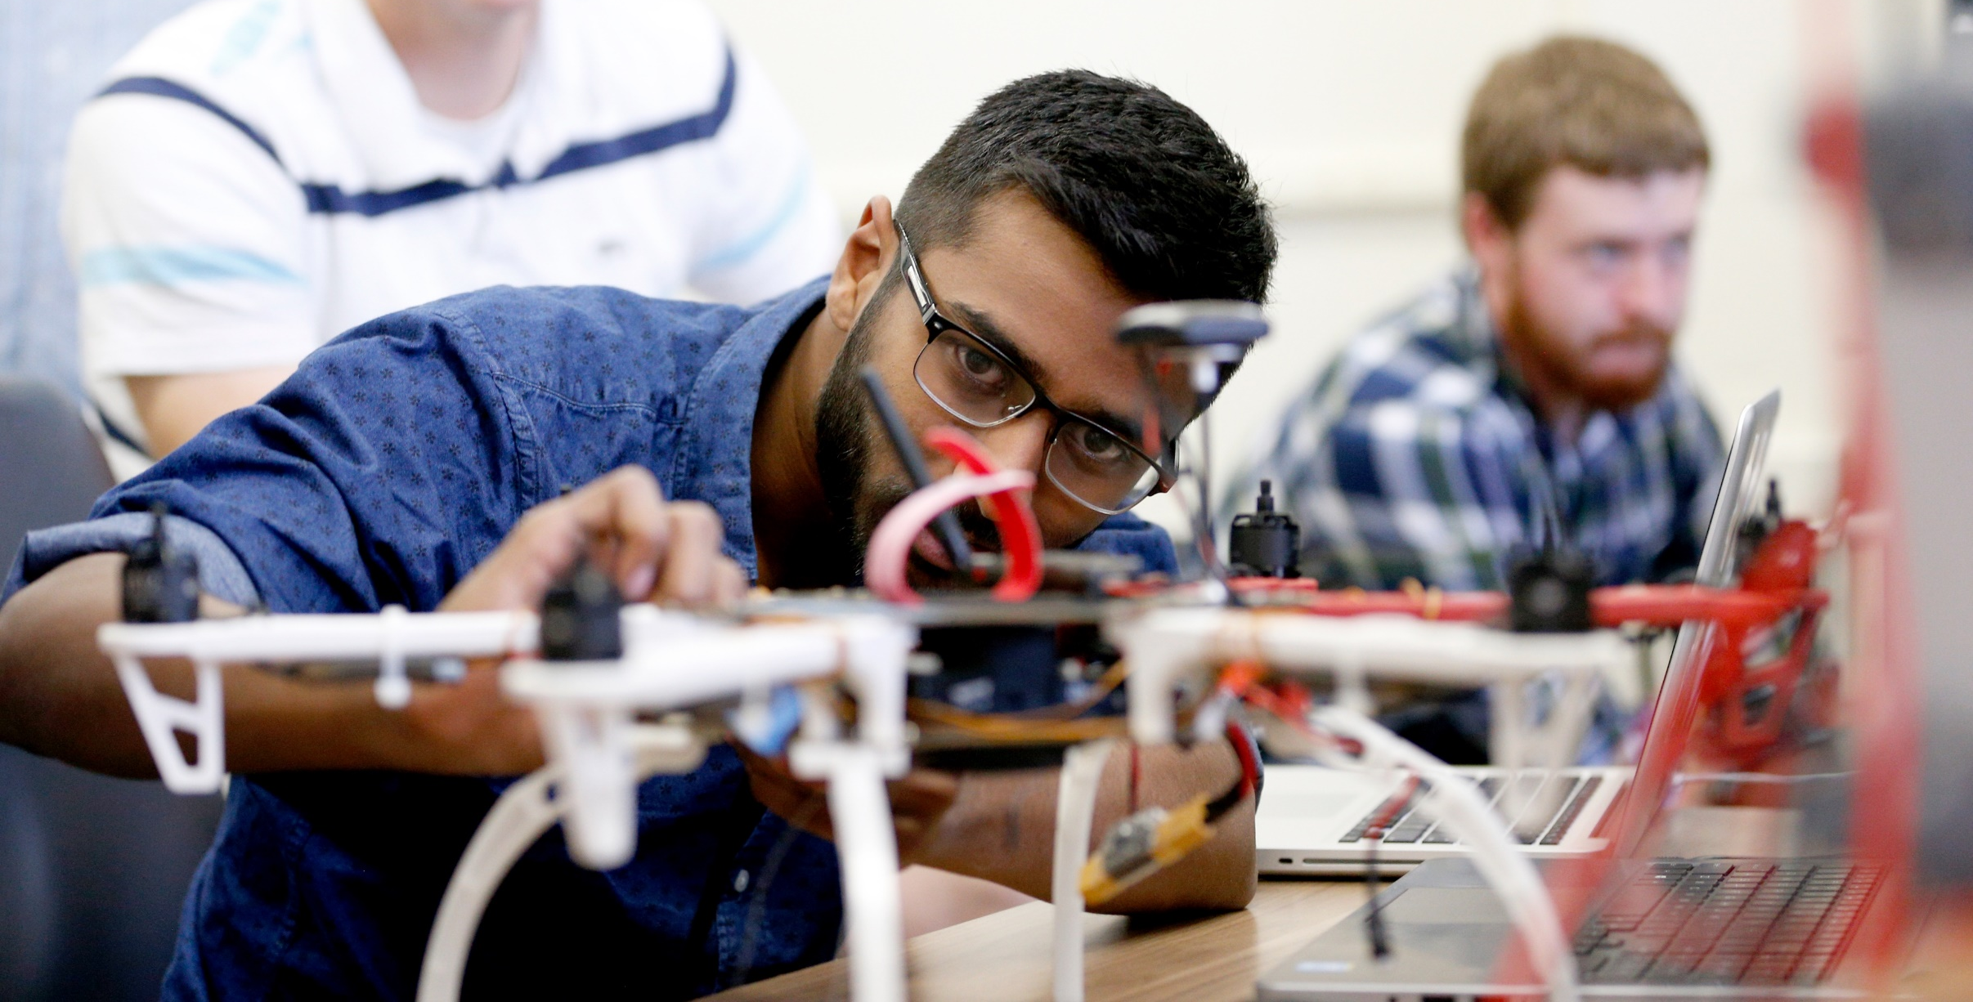
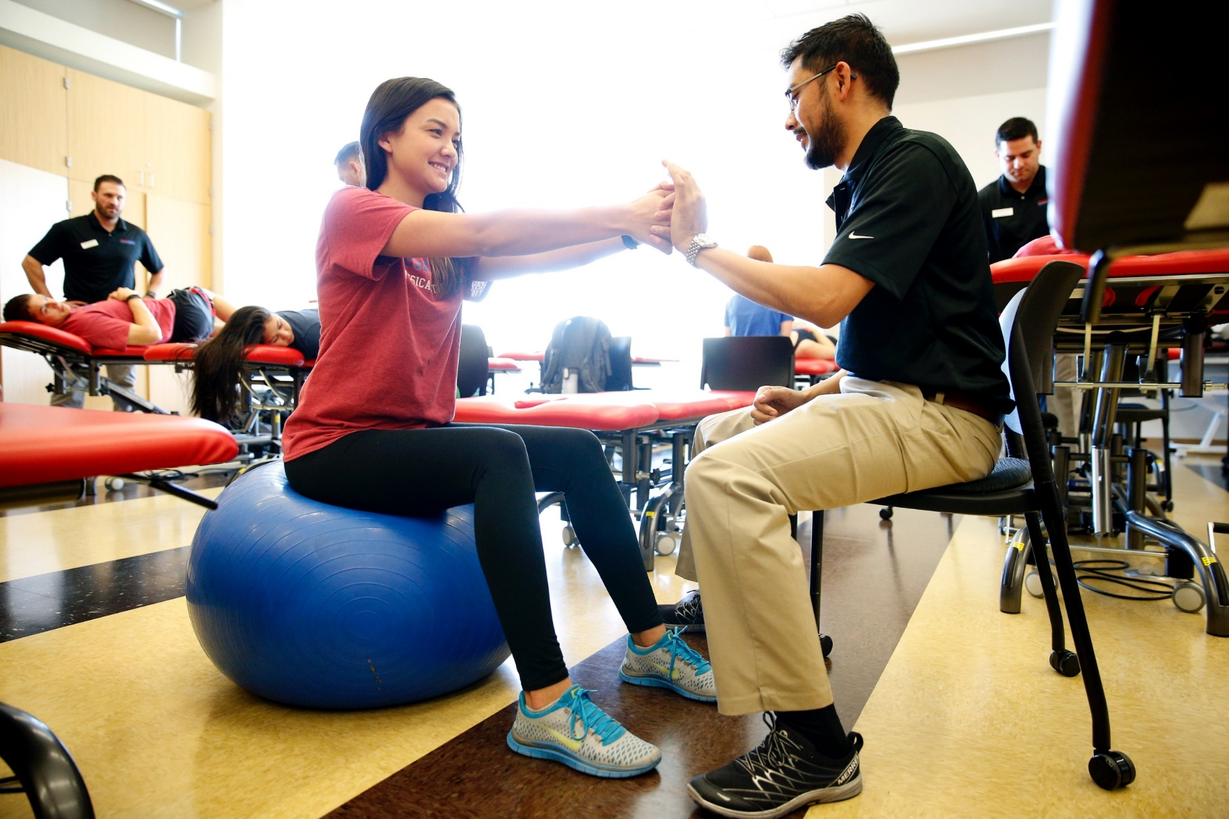
Creativity & Innovation for Excellence (CAIFE) Undergraduate Creative & Research Opportunities
HOST Division of Research and Graduate Studies
STUDENTS ●post past experiences and current interests
●find projects
FACULTY ●post new research opportunities
●find students
Team: Amanda Dinscore, Tamas Forgacs, Maribell Garcia, Rodrigo Gomez, Primavera Leal Martinez, Ulrike Müller Sponsors: Bob Harper & Dennis Nef
A Resource for Faculty & Students
Proposal
Rebrand and Promote ‘Research’
include creative activities in all disciplines
emphasize value of undergraduates participating in creative and research activities to build professional skills
Create a Research Pipeline
incorporate research into lower-division undergraduate curriculum (CUREs)
encourage CURE symposia to create face-to-face networking opportunities to faculty and students
Create an Undergraduate Research Opportunities Database so that :
students can search for creative and research opportunities based on their interests
faculty can post opportunities and identify students for creative and research projects
Project Aims
increase the number of undergraduate students who engage in creative and research activities
connect students and faculty to conduct creative and research activities
develop an online database and ‘match-making’ service for undergraduates and faculty
Benefits of Student Research
explore career opportunities
build transferrable skills (communication, team work, problem-solving, project management)
network with mentors and peers
contribute to your field and your community
discover a passion for a new area of expertise
Why We Need This Resource
Although 60% of faculty say that undergraduate research is important, less than 20% of our students do research. Only half of the students who plan to do research as freshmen end up doing research; most undecided students lose interest.
Have you or do you plan to work with a faculty member on a research project before you graduate?
21
198
403
323
404
951
378
525
First Year Students
Seniors

